Slide 1
How we can change Indian Waste management System ?

Slide 2
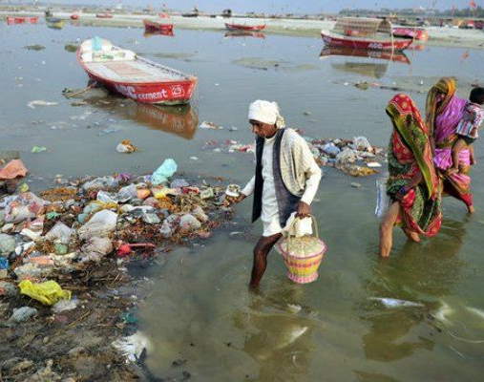
This is how, Ganga looks, unfortunately 2nd most polluted river on the earth.
Every year we sweep 115,000 tons of plastic into it.
India is one of the biggest contributor of non-biodegradable waste.
The question is why this happens?
Link - https://bit.ly/3qXyHYI

Slide 3
This happens because -
India has enough workforce to recycle waste (majorly plastic waste) but the issue is “How to take the waste at the recycling plant ”. In tier 1 cities (Delhi, Mumbai, Chennai etc.) it is easier, but when it comes to tier 2 cities and then to rural areas of the country where more than 60% (According to 2021 census estimates) lives in rural areas as of now it is nearly impossible to take the waste to management plant.
So, What’s the solution?

Slide 4
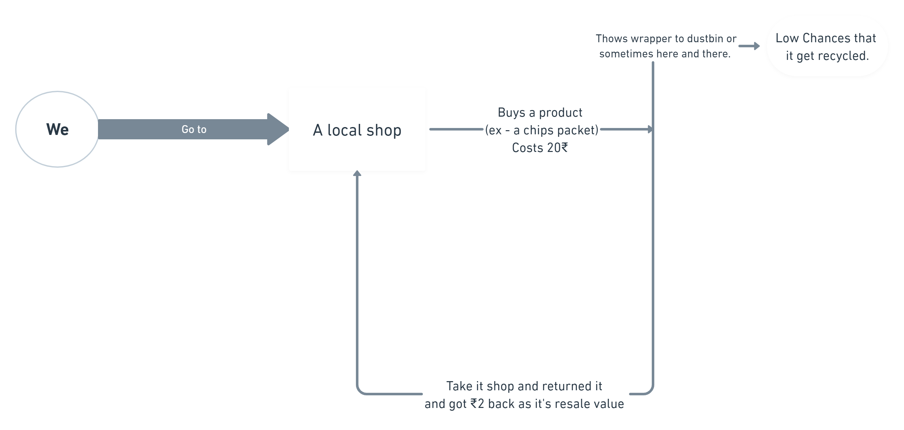
Why not have a resale value?
The first and the obvious question arises is – what is resale value?

